Slide 1

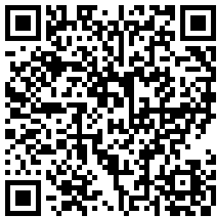

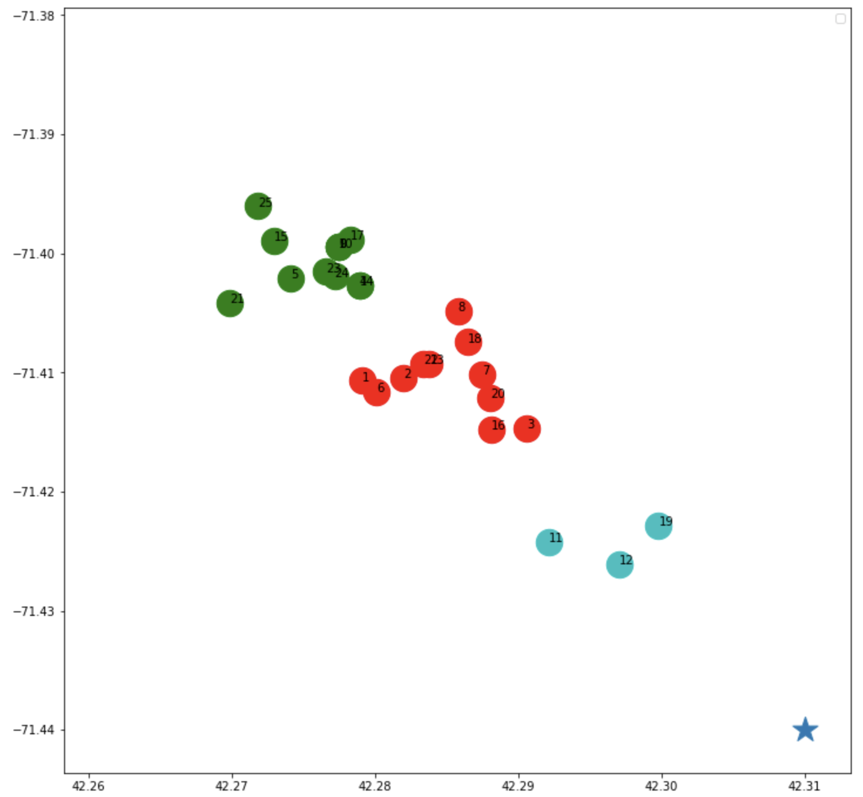
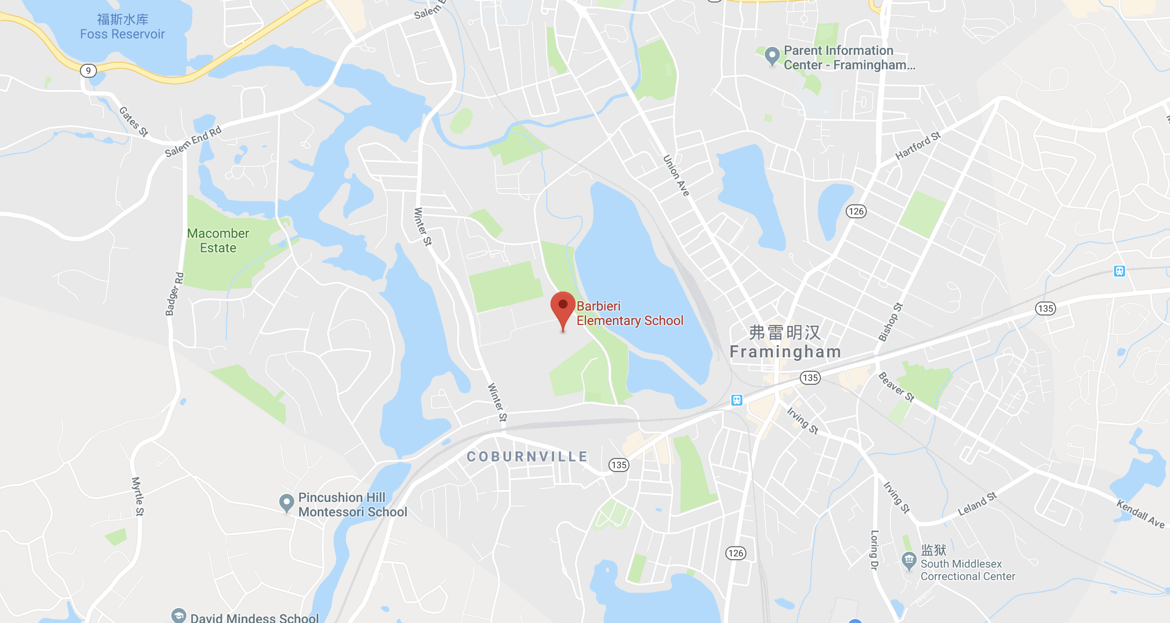
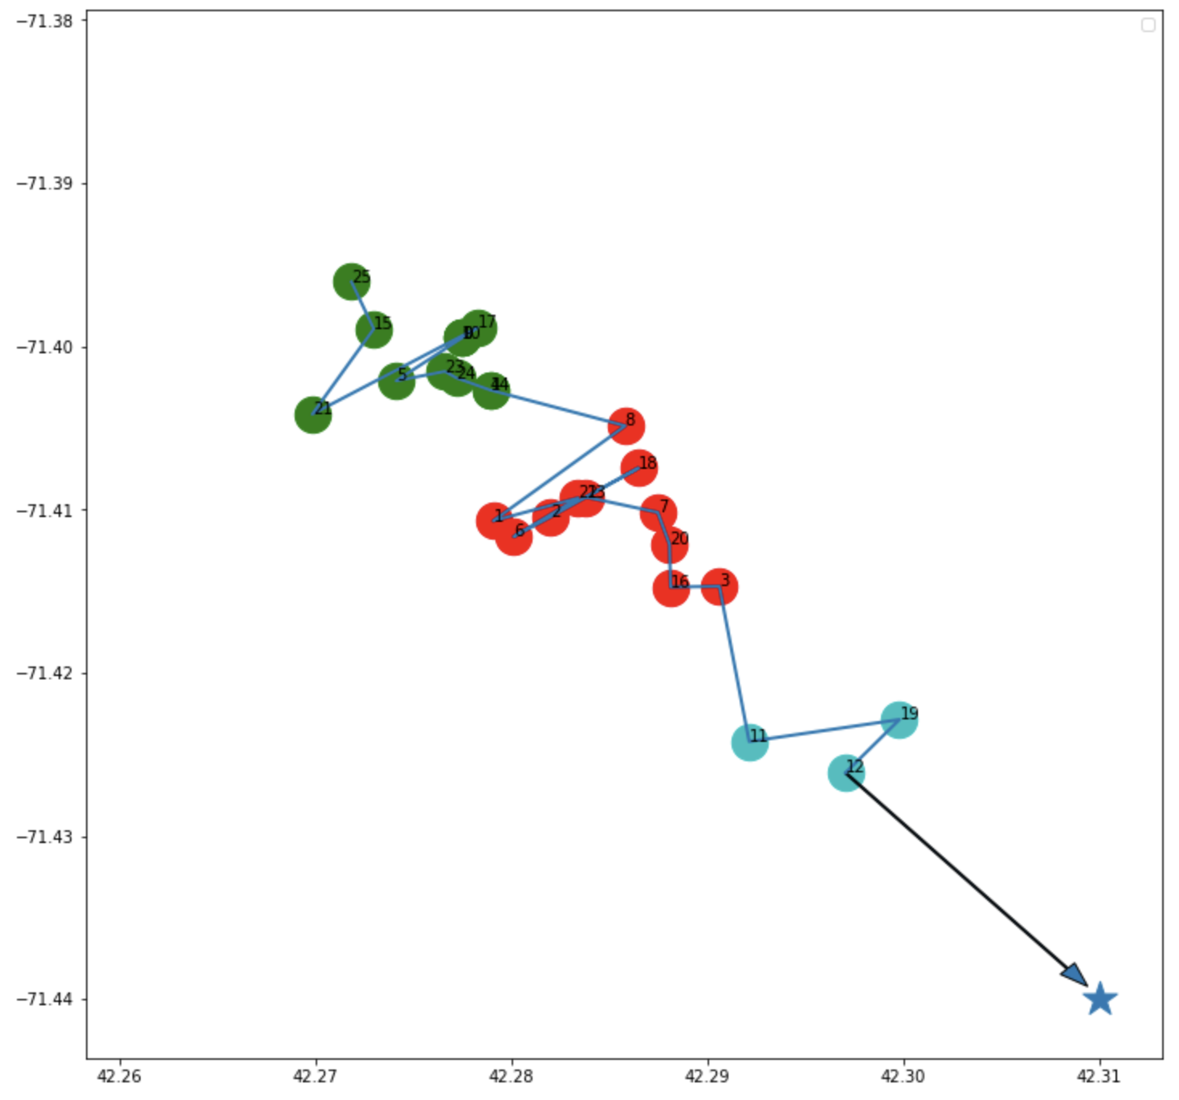
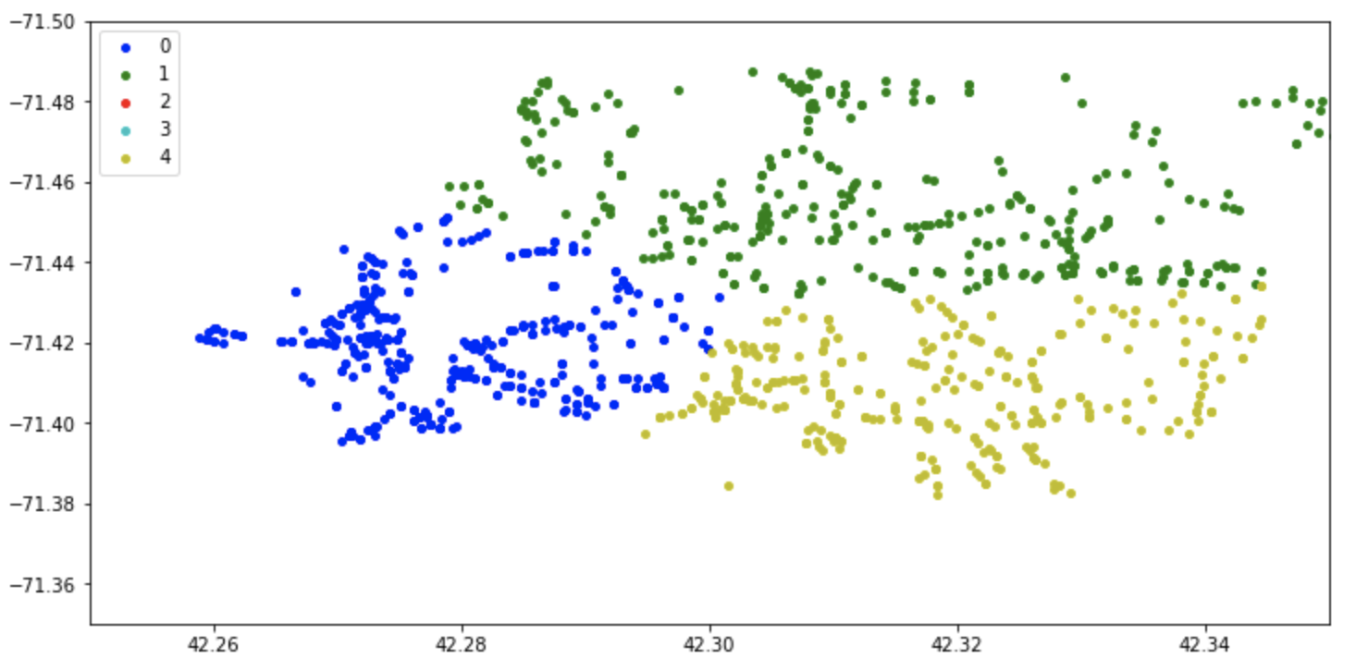

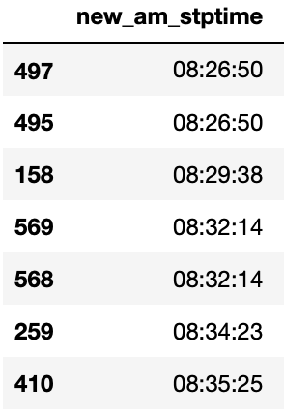
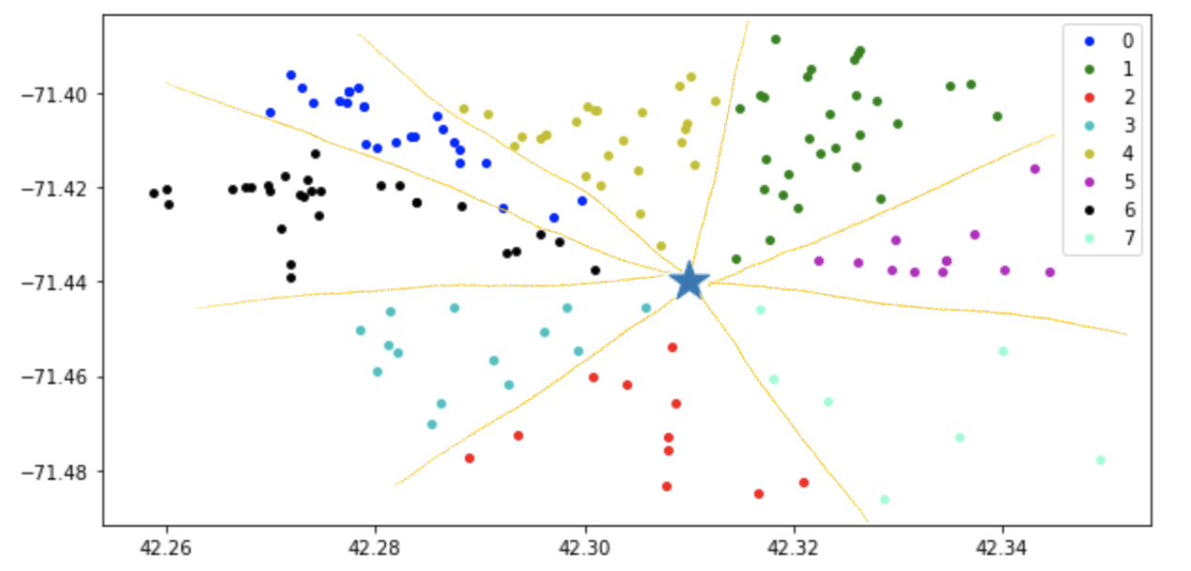
FRAMINGHAM BUS PROJECT
GitHub
Yujia Wang Yinzhu Su Sang Jae Park
yujia8@bu.edu yzsu@bu.edu park4s@bu.edu
1
Data Collection
MAIN GOALS
5
Cluster the Stops
2017-2018 Framingham Bus Data
X Public Schools in Framingham
X Students in total
Elementary, Middle, High
For one piece of pizza
Cluster it by its Orthogonal Coordinates(3 clusters for each piece of pizza)
Sort these three clusters by their central distance to school
School buses are expensive to run, we need to find an efficient way to reform the bus routes for minimizing the quantity of buses needed in the overall system without sacrificing timely student arrivals to school and drop-off at home.
2
Data Cleaning
Remove useless columns
Filter rows whose data is not integrity
Sort the data by school and time
3
Stops Visualization
Calculate the Route
Using Google Map API
Get the latitude and longitude of all schools and stops
Plot schools and stops
6
Calculate the distances of each stop to the school
Sort the stops by the distances
Connect the stops from the farthest to school
1
MAIN TECHNIQUE
K-Means Clustering
7
New Stops Schedule
Make the Pizza!
Using Google Map API to calculate the duration of driving between to stops
Given the Drop Out time, reversely calculate each stops corresponding time
4
K-means clustering is a type of unsupervised learning, which is used when you have unlabeled data (i.e., data without defined categories or groups). The goal of this algorithm is to find groups in the data, with the number of groups represented by the variable K. The algorithm works iteratively to assign each data point to one of K groups based on the features that are provided.
Using K-Means algorithm
Cluster the Stops by angles of their Polar Coordinates
School is in the central
Just like a large piazza!
Google Maps API
We mainly used two APIs in Google Maps APIs: Geocoding API and Distance Matrix API.
The Geocoding is the process of converting addresses (like a street address) into geographic coordinates (like latitude and longitude), which you can use to place markers on a map, or position the map. Reverse geocoding is the process of converting geographic coordinates into a human-readable address.
The Distance Matrix API is a service that provides travel distance and time for a matrix of origins and destinations. The API returns information based on the recommended route between start and end points, as calculated by the Google Maps API, and consists of rows containing duration and distance values for each pair.
8
Rearrange the Buses
Allocate the amount of buses for schools according to the amount of their students
Arrange buses to each school according to their capacities

